Slide 1
Lecture 3 : Object Oriented Design
(chapter 3. of Timothy Budd’s “Intro to OOP” book)
Acknowledgement : courtesy of Prof. Timothy Budd lecture slides

Slide 2
OOP Technique Example : Responsibility Driven Design
OOP = a set of interacting objects
Each object is a component that has responsibility in a community.
System is divided into various activities that the system has to perform. Then, those activities(responsibilities) are distributed among objects in the system.
After completing a list of responsibilities, we need to decide a set of objects and determine which responsibilities should be assigned to which object.
Responsibilities in an object should be closely related.

Slide 3
Design Process
Specification
  Imprecise
  Ambiguous
  Unclear
Software System Design
  concrete logic

Slide 4
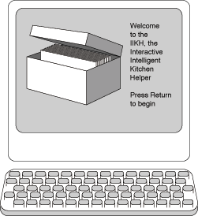
Development Process
Initial Description(Specification)
Refine Specification
Identification of Components
Identification of Components Responsibilities
Formalize the interface
Designing the subsystem
Implementing components
Integration of components
Maintenance & Evolution

Slide 5
An Example, the IIKH
IIKH(Intelligent Interactive Kitchen Helper)
Imagine you are the chief software architect in a major computing firm
The president of the firm rushes into your office with a specification for IIKH, the next PC-based product. It is drawn on the back of a dinner napkin

Slide 6
1.Initial Description
Briefly, IIKH is a PC-based application
  that will replace the box of index cards of recipes in the average kitchen. But more than simply maintaining a database of recipes, the kitchen helper assists in the planning of meals for an extended period, say a week. The user of the IIKH can sit down at a terminal, browse the database of recipes, and interactively create a series of menus. The IIKH will automatically scale the recipes to any number of servings and will print out menus for the entire week, for a particular day, or for a particular meal. And it will print an integrated grocery list of all the items needed for the recipes for the entire period.
Initial description : Ambiguous, Unclear
We need to clarify the ambigueties in the description.

Slide 7
2. Refine Specification
(Working Through Scenarios)
Because of the ambiguity in the specification, the major tool we will use to uncover the desired behavior is to walk through application scenarios
  Pretend we had already a working application. Walk through the various uses of the system
  Establish the ``look and feel'' of the system
  Make sure we have uncovered all the intended uses
  Develop descriptive documentation
  Create the high level software design
Other authors use the term ``use-cases'' for this process of developing scenarios
  시스템 사용에 대한 시나리오의 집합

Slide 8
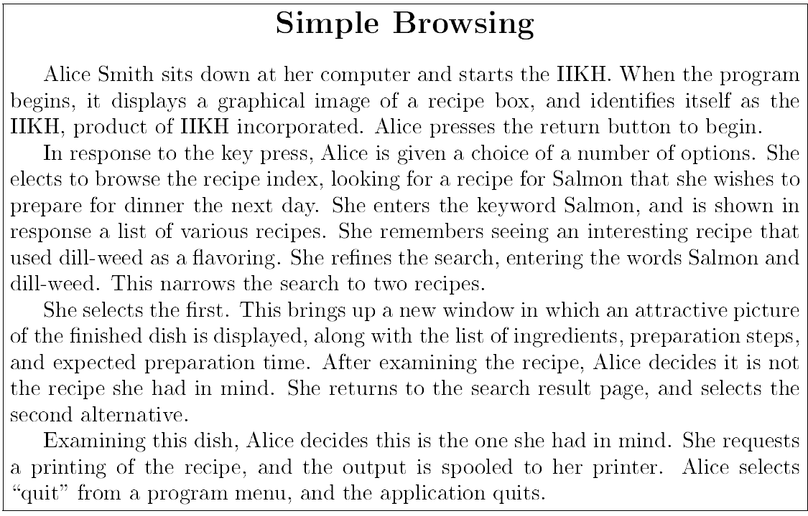
Scenario Example

Slide 9
Abilities of the IIKH
Here are some of the things a user can do with the IIKH
  Browse a database of recipes
  Add a new recipe to the database
  Edit or annotate an existing recipe
  Plan a meal consisting of several courses
  Scale a recipe for some number of users
  Plan a longer period, say a week
  Generate a grocery list that includes all the items in all the menus for a period
  …

Slide 10
3. Identification of Components
Component
  an abstract design entity with which we can associate responsibilities for different tasks
  must have a small well defined set of responsibilities
  should interact with other components to the minimal extent possible

Slide 11
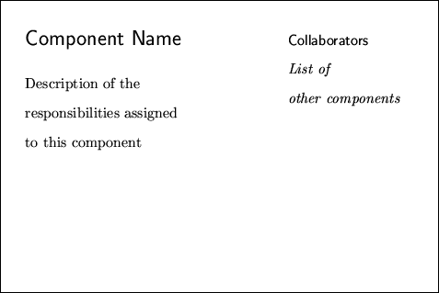
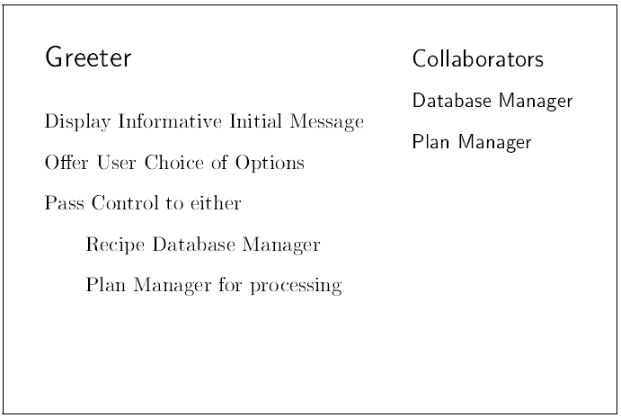
4. Identification of Components Responsibilities
CRC Cards
  Components are most easily described using CRC cards

Slide 12
The first component, The Greeter
When the application is started, the Greeter puts an informative and friendly welcome window (the greeting) on the screen
Actions
  Casually browse the database of recipes
  Add a new recipe
  Edit or annotate a recipe
  Review a plan for several meals
  Create a plan of meals

Slide 13
The Recipe Database Component
Actions
  Must Maintain the Database of recipes
  Must Allow the user to browse the database
  Must permit the user to edit or annotate an existing recipe
  Must permit the user to add a new recipe

Slide 14
Responsibilities of a Recipe
Tasks
  Maintains the list of ingredients and transformation algorithm
  Must know how to edit these data values
  Must know how to interactively display itself on the output device
  Must know how to print itself
  etc

Slide 15
The Planner Component
Permits the user to select a sequence of dates for planning
Permits the user to edit an existing plan
Associates with Date object

Slide 16
The Date Component
User can edit specific meals
User can annotate information about dates
  ''Bob's Birthday'', ``Christmas Dinner'', …
Can print out grocery list for entire set of meals

Slide 17
The Meal Component
holds information about a single meal
  Allows user to interact with the recipe database to select individual recipes for meals
  User sets number of people to be present at meal, recipes are automatically scaled
  Can produce grocery list for entire meal, by combining grocery lists from individual scaled recipes

Slide 18
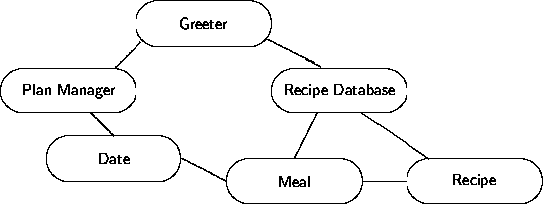
The Six Components
everything can be accomplished using only six software components
You can at this point assign the different components to different programmers for development

Slide 19
Characteristics of Components
Behavior and State
Instances and Classes
Coupling and Cohesion
Interface and Implementation

Slide 20
Behavior and State
Behavior
  the set of actions a component can perform
State
  all the information (data values) held within a component
it is common for behavior to change state

Slide 21
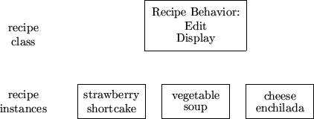
Instances and Classes
There are likely many instances of recipe, but they will all behave in the same way
We say the behavior is common to the class Recipe

Slide 22
Coupling and Cohesion
Cohesion
  the degree to which the tasks assigned to a component seem to form a meaningful unit.
  Want to maximize cohesion
Coupling
  the degree to which the ability to fulfill a certain responsibility depends upon the actions of another component
  Want to minimize coupling

Slide 23
Interface and Implementation
We have characterized software components by what they can do
The user of a software component need only know what it does, not how it does it

Slide 24
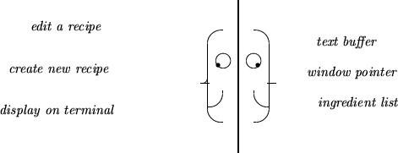
Two views of a Software System
information hiding
  purposeful hiding of implementation details

Slide 25
Public and Private View
Public view
  those features (data or behavior) that other components can see and use
Private view
  those features (data or behavior) that are used only within the component

Slide 26
5. Formalize the Interface
formalize the channels of communication between the components
  The general structure of each component is identified
  Components with only one behavior may be made into functions
  Components with many behaviors are probably more easily implemented as classes
  Names are given to each of the responsibilities - these will eventually be mapped on to procedure names
  Function parameters should be identified
  Information is assigned to each component and accounted for
  Scenarios are replayed in order to ensure all data is available

Slide 27
The selection of names
should be evocative in the context of the problem
should be short
should be pronounceable (read them out load)
Names should be consistent within the project
Avoid digits within a name

Slide 28
6. Design
Transform description into SW layout
Design data structures in each component
Transform behavior description into algorithms.

Slide 29
7. Implementing Components
implement the desired activities in each component
Unit testing: Subsystems are validated individually
  Identify necessary conditions for correct functioning.
  Test input values to verify that SW component will perform correctly when presented with legal input values

Slide 30
8. Integration of Components
Components are slowly integrated into completed system, using stubs as yet unimplemented parts.
Stubs
  simple dummy routines with no behavior or with very limited behavior
Errors discovered during integration cause reinvestigation of validation techniques performed at the subsystem level.

Slide 31
9. Maintenance and Evolution
Software Maintenance
  Activities subsequent to the delivery of the initial working version of SW system
Software does not remain fixed after the first working version is released
  Errors or bugs can be discovered. Must be corrected
  Requirements may change. Say as a result of government regulations, or standardization among similar products
  Hardware may change
  Users expectations may change. Greater functionality, more features. Often as a result of competition from similar products
  Better documentation may be required
Good Design
  Recognizes the inevitability of changes and plans an accommodation for them from the very beginning

Slide 32
Prepare for Change!
User requirements change with experience, hardware changes, government regulations change.
  Try to predict the most likely sources of change, and isolate the effect. Common changes include interfaces, file formats, communication protocols
  Isolate interfaces to hardware that is likely to change
  Reduce dependency of one software component on another
  Keep accurate record of the reasoning behind every major decision in the design documentation.

Slide 33
Common Design Flaws
Direct modification
  Components that make direct modification of data values in other components are a direct violation of encapsulation
Too Much Responsibility
  Components with too much responsibility are difficult to understand and to use
No Responsibility
  Components with no responsibility serve no purpose
Components with unused responsibility
  Usually the result of designing software components without thinking about how they will be used
Misleading Names
  Names should be short and unambiguously indicate what the responsibilities of the component involve

Slide 34
보충 자료 (강의 페이지)
IIKH: Object Oriented Design (Tim Budd, Intro to OOP, Chapter 3)
  Project 1 참고 자료

Slide 35
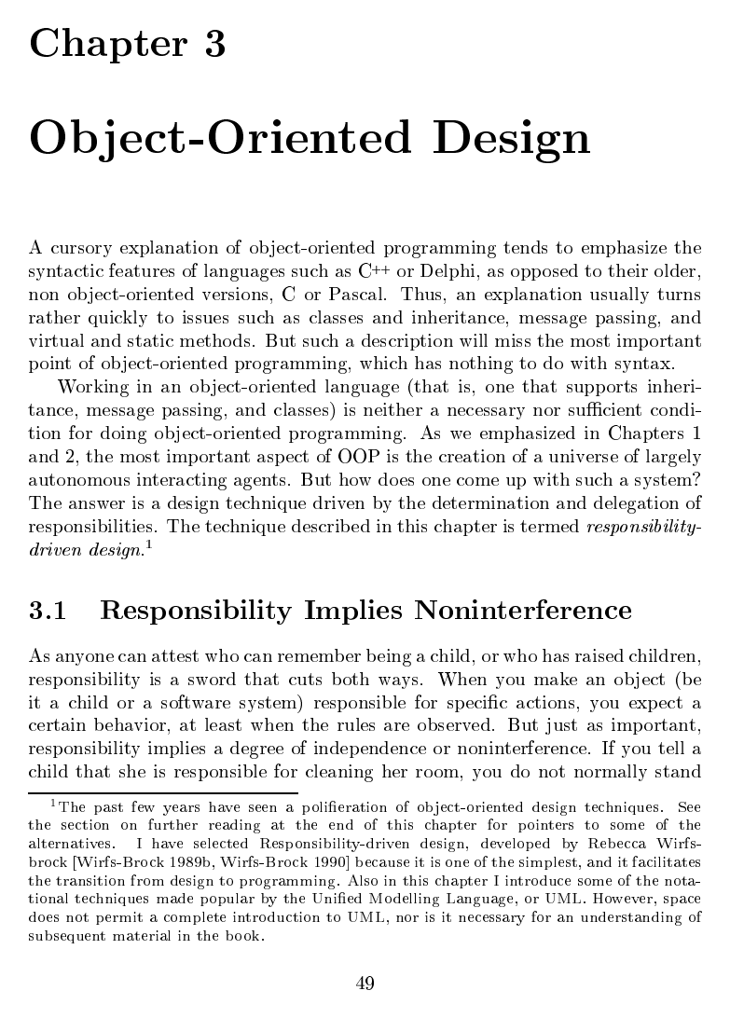
Budd Ch.3 Object-Oriented Design (1/23)

Slide 36
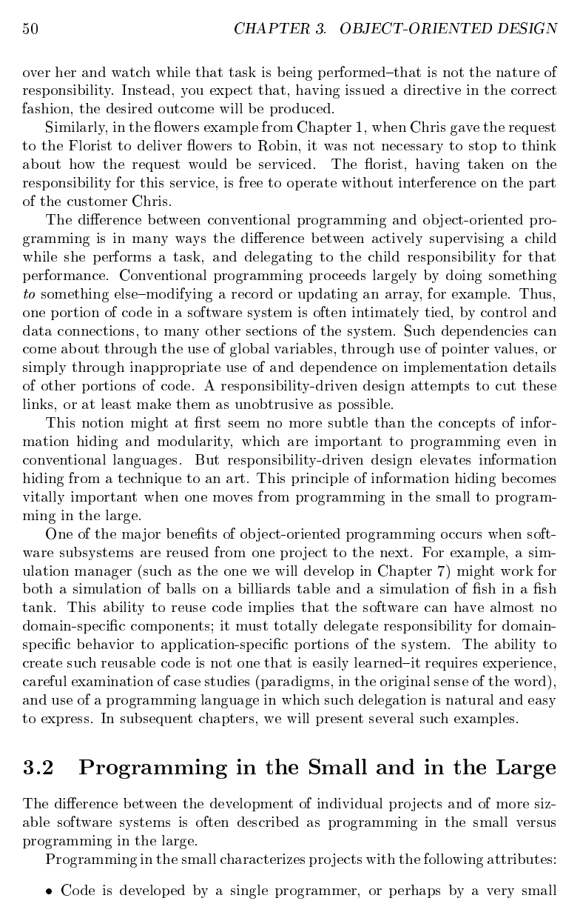
Budd Ch.3 Object-Oriented Design (2/23)

Slide 37
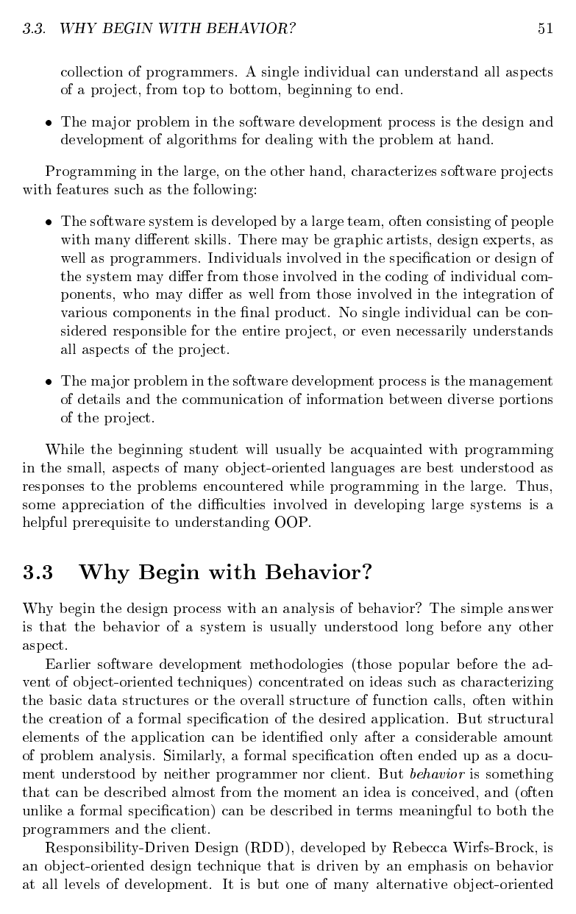
Budd Ch.3 Object-Oriented Design (3/23)

Slide 38
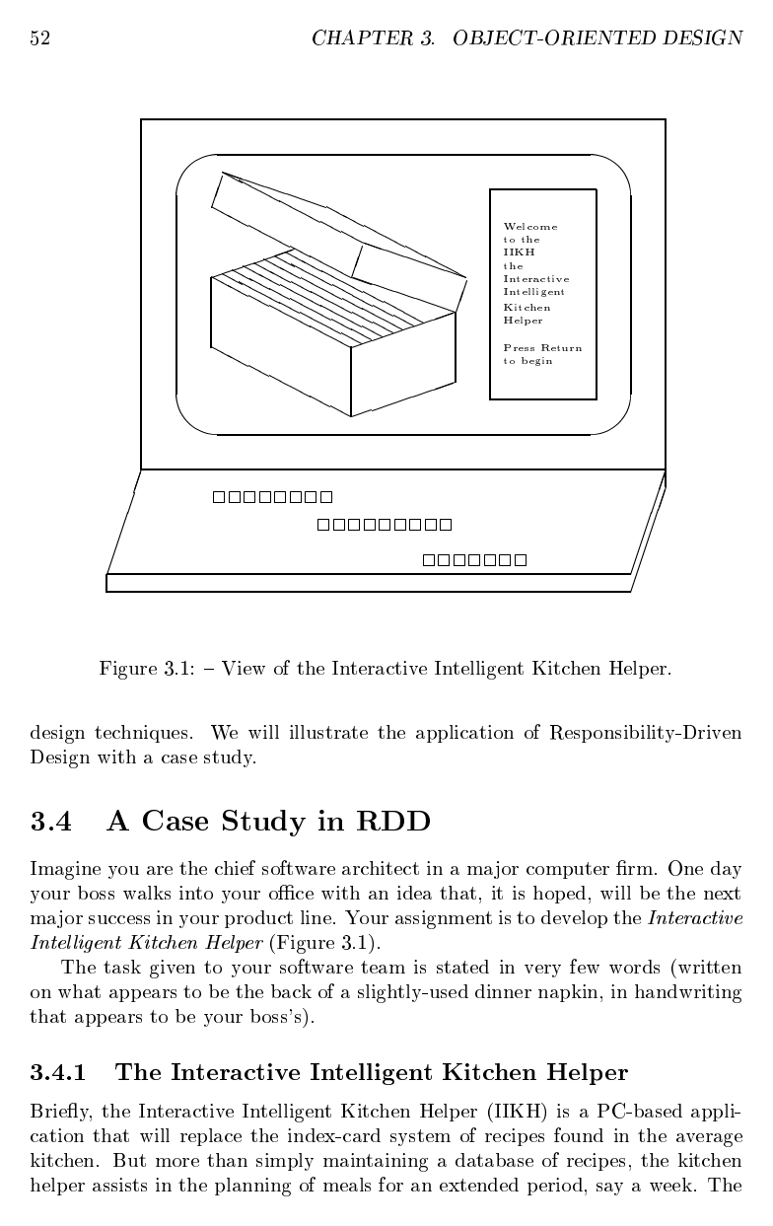
Budd Ch.3 Object-Oriented Design (4/23)

Slide 39
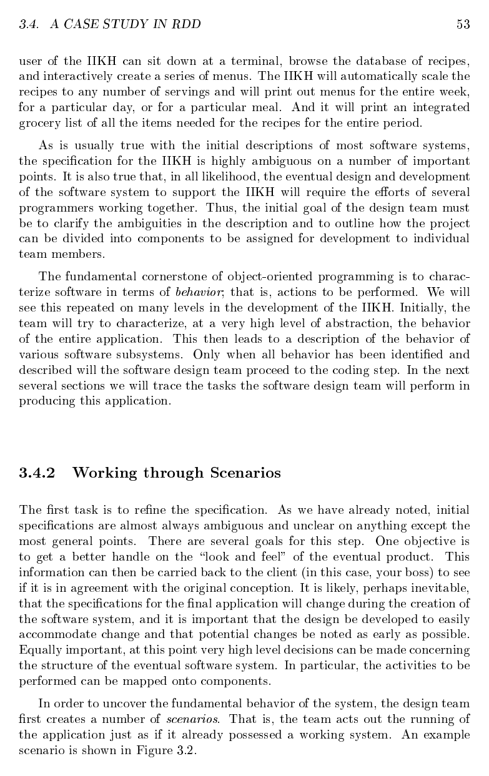
Budd Ch.3 Object-Oriented Design (5/23)

Slide 40
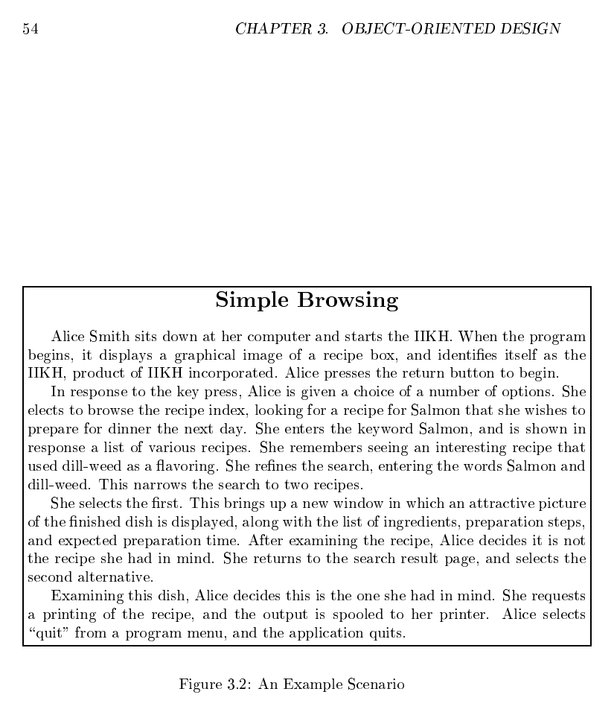
Budd Ch.3 Object-Oriented Design (6/23)

Slide 41
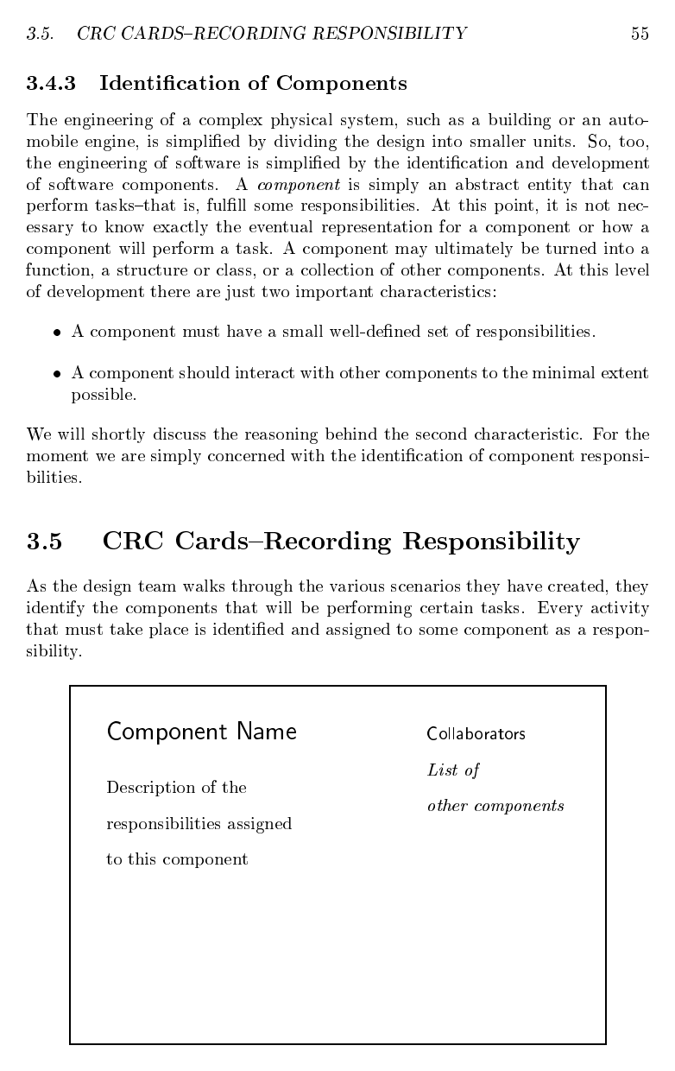
Budd Ch.3 Object-Oriented Design (7/23)

Slide 42
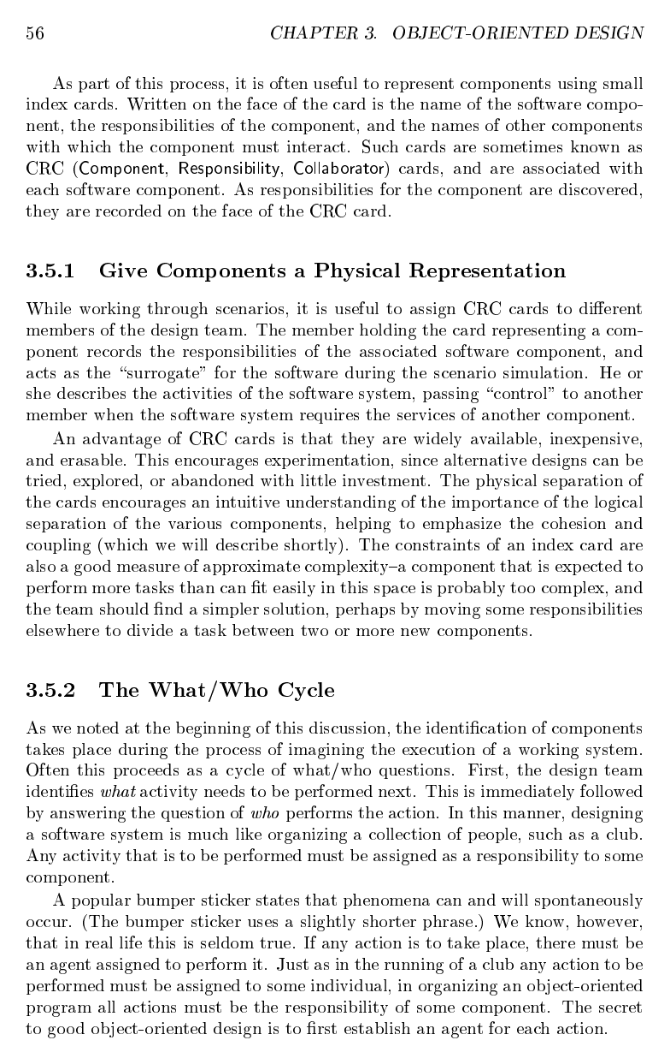
Budd Ch.3 Object-Oriented Design (8/23)

Slide 43
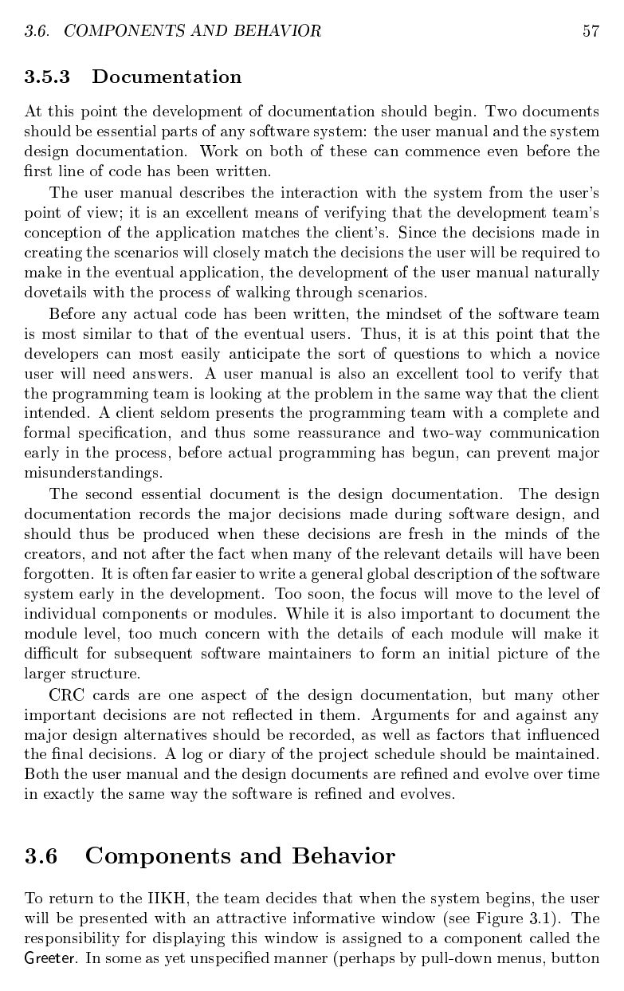
Budd Ch.3 Object-Oriented Design (9/23)

Slide 44
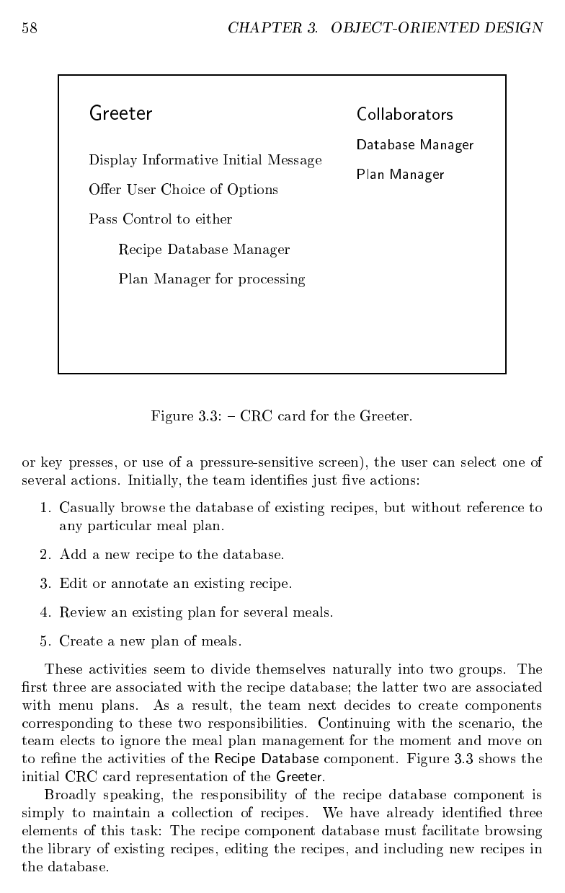
Budd Ch.3 Object-Oriented Design (10/23)

Slide 45
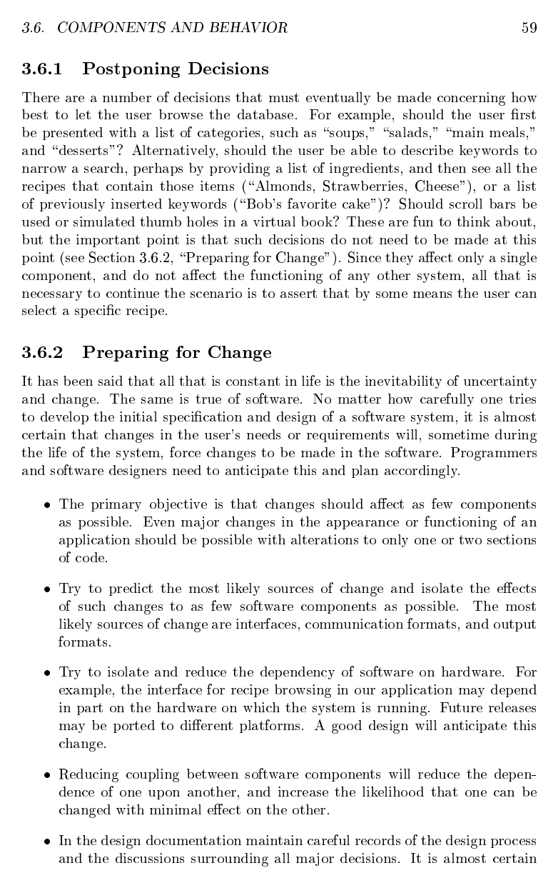
Budd Ch.3 Object-Oriented Design (11/23)

Slide 46
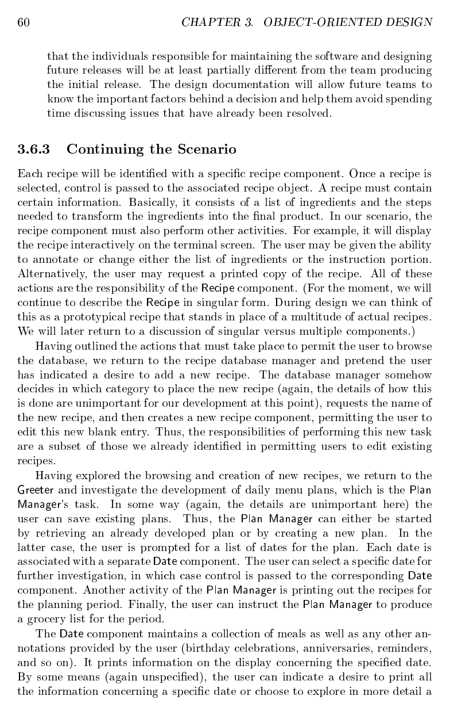
Budd Ch.3 Object-Oriented Design (12/23)

Slide 47
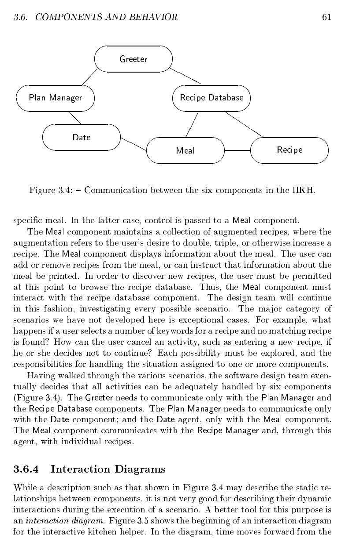
Budd Ch.3 Object-Oriented Design (13/23)

Slide 48
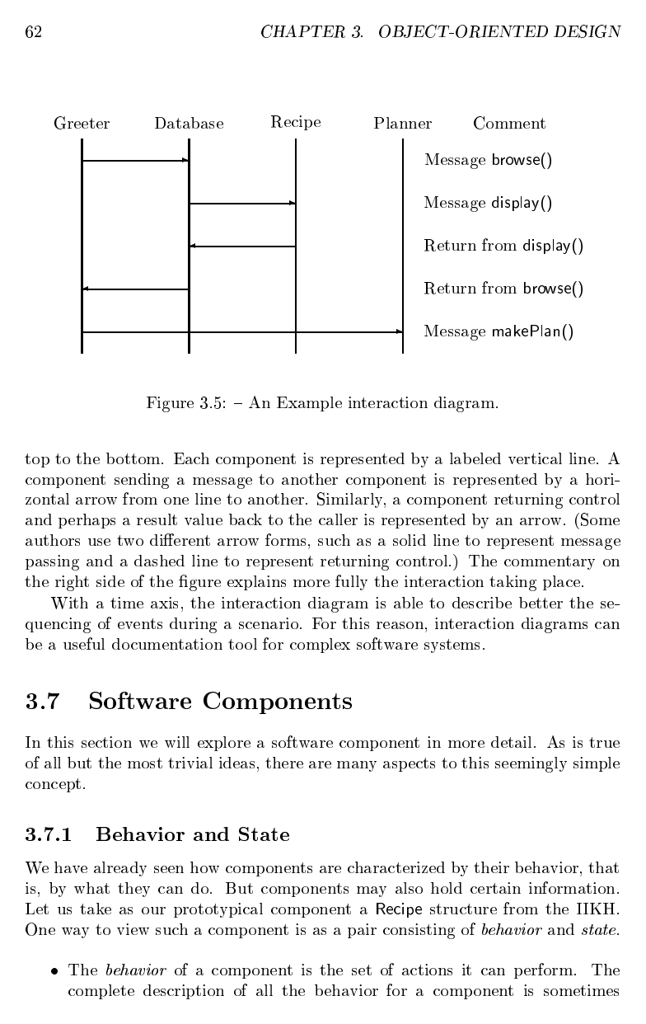
Budd Ch.3 Object-Oriented Design (14/23)

Slide 49
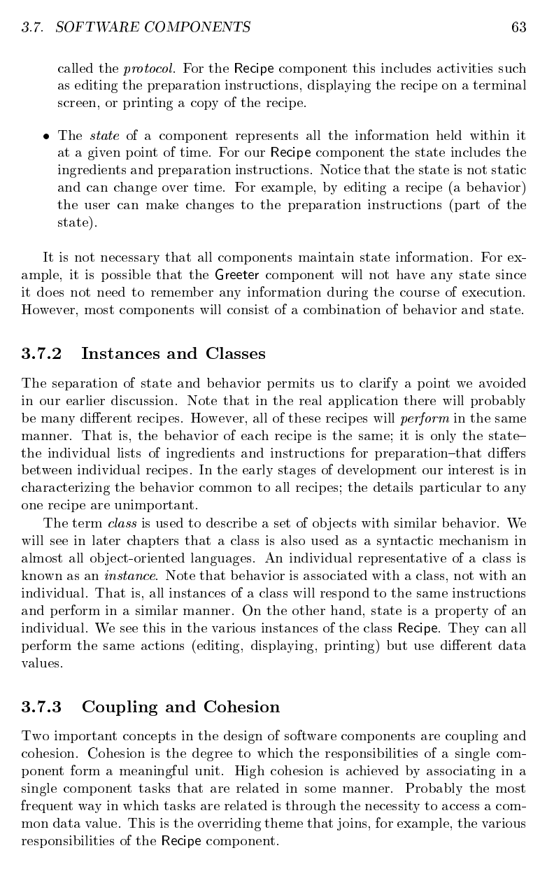
Budd Ch.3 Object-Oriented Design (15/23)

Slide 50
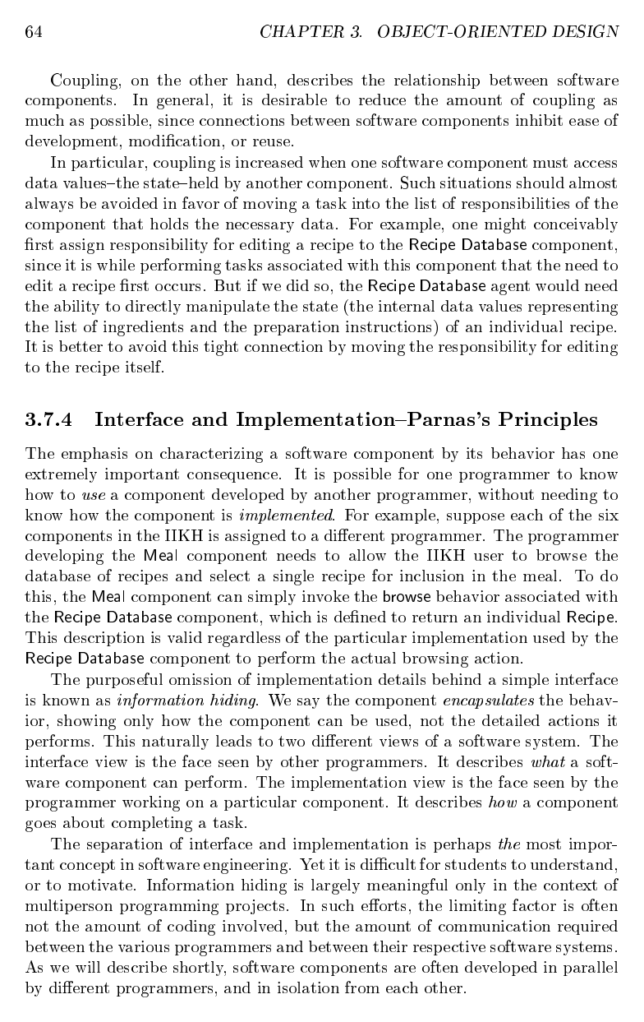
Budd Ch.3 Object-Oriented Design (16/23)

Slide 51
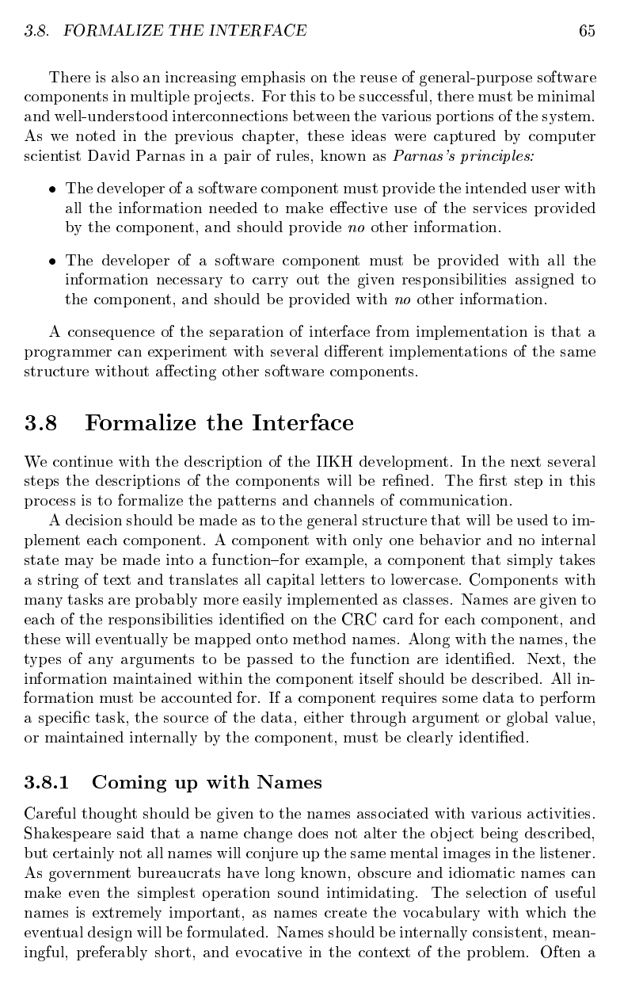
Budd Ch.3 Object-Oriented Design (17/23)

Slide 52
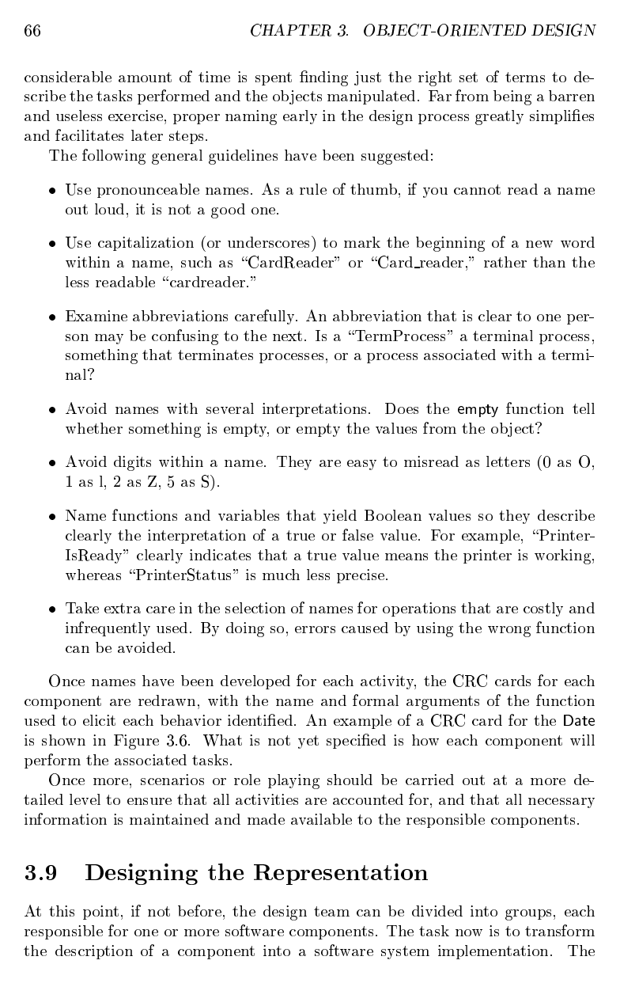
Budd Ch.3 Object-Oriented Design (18/23)

Slide 53
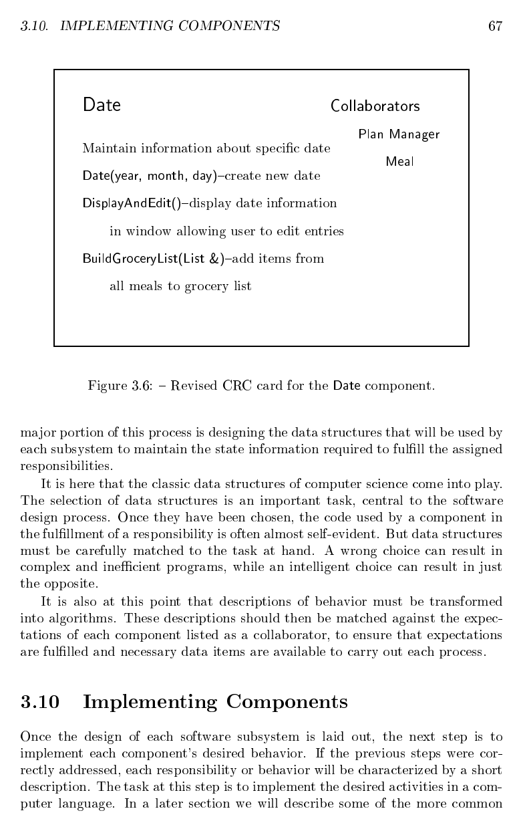
Budd Ch.3 Object-Oriented Design (19/23)

Slide 54
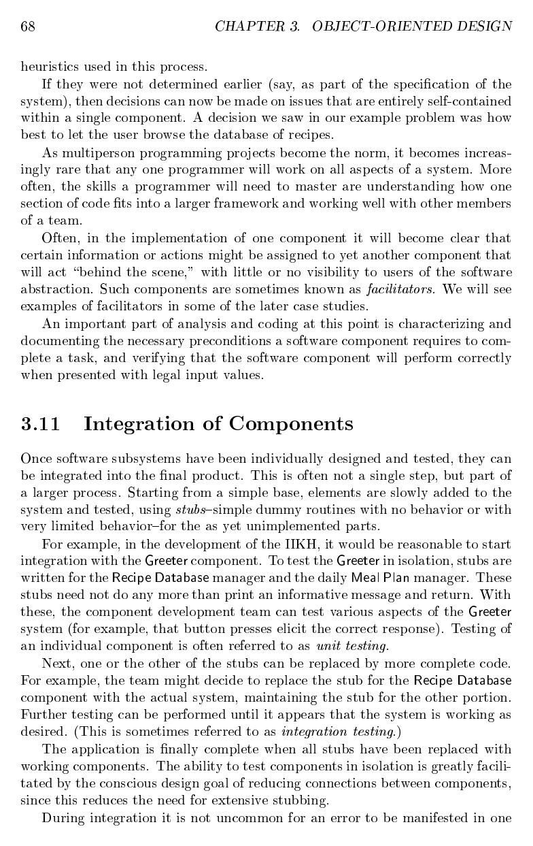
Budd Ch.3 Object-Oriented Design (20/23)

Slide 55
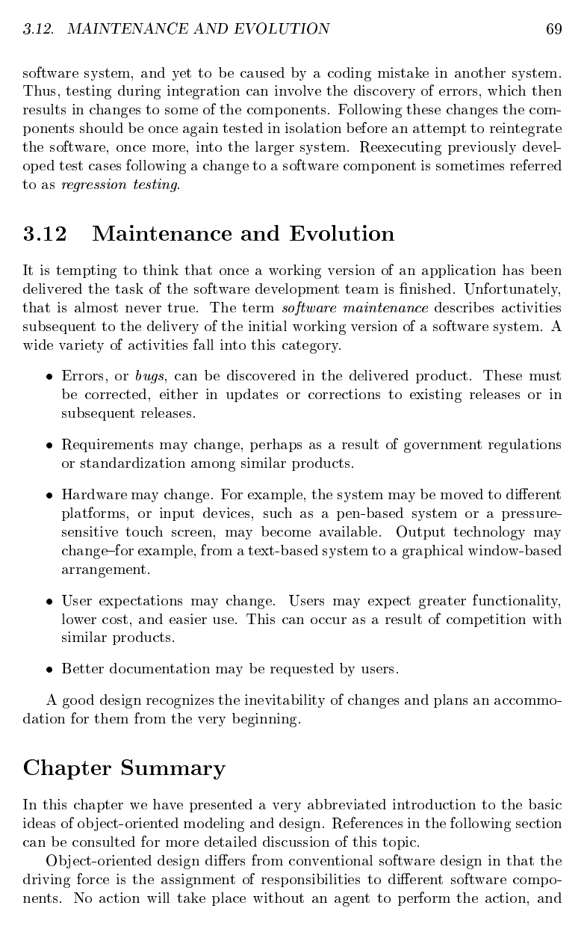
Budd Ch.3 Object-Oriented Design (21/23)

Slide 56
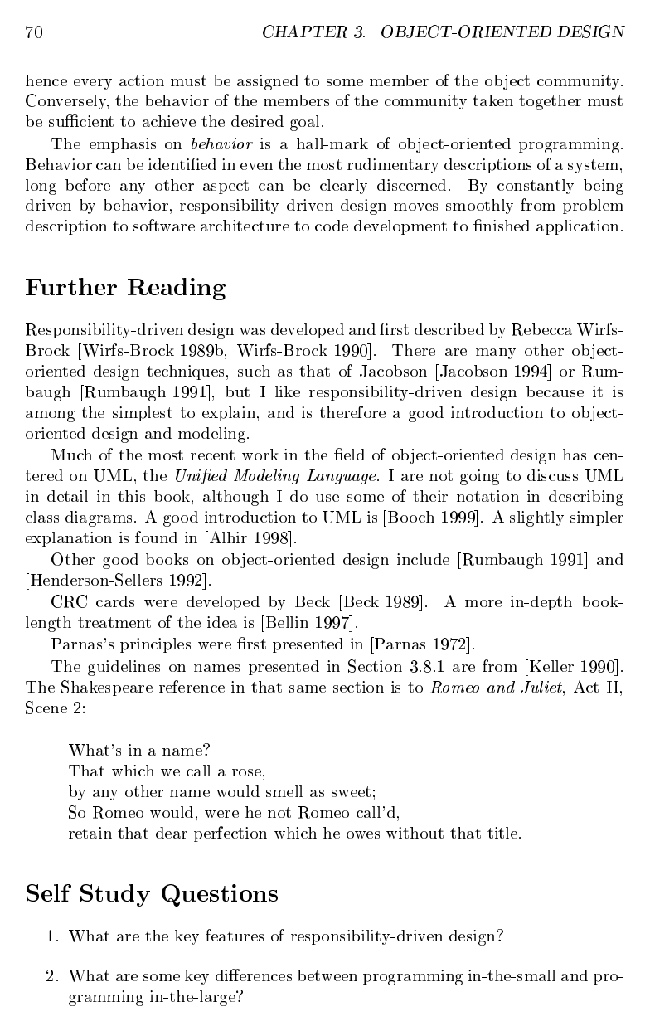
Budd Ch.3 Object-Oriented Design (22/23)

Slide 57
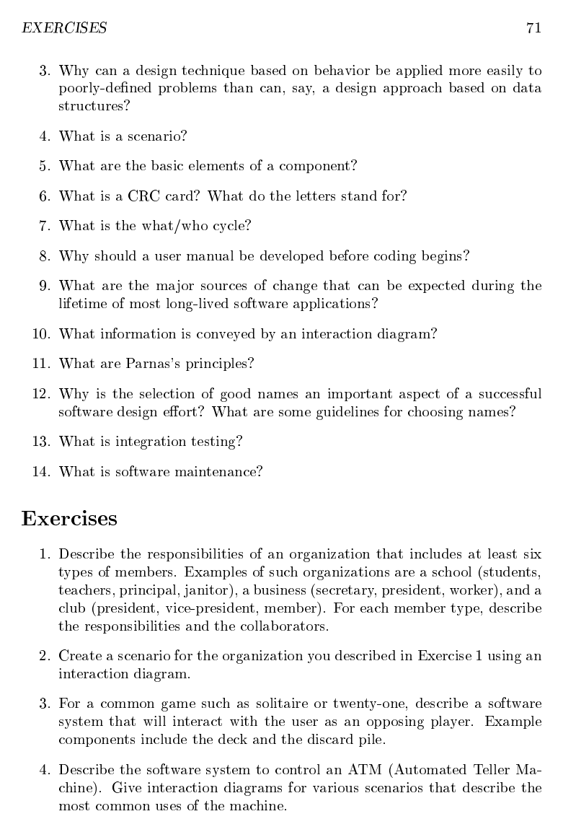
Budd Ch.3 Object-Oriented Design (23/23)

